Slide 1
Architectural principles and patterns

Slide 2
Software Architecture (recap)
A subsystem is a set of collaborating components performing a given task.
A component is an encapsulated part of a software system. A component has an interface.
A software architecture is a description of the subsystems and components of a software system and the relationships between them.
Subsystems and components are typically specified in different views to show the relevant functional and non-functional properties of a software system.
4+1 view

Slide 3
Design vs Architectural Patterns
A Design pattern provides a scheme for refining the subsystems or components of a software system, or the relationships between them. It describes a commonly recurring structure of communicating components that solves a general design problem within a particular context.
An Architectural Pattern expresses a fundamental structural organization schema for software systems. It provides a set of predefined subsystems, their responsibilities, and includes rules and guidelines for organizing the relationships between them.

Slide 4
Pattern Elements
Name
Problem
Solution
Structure
Examples

Slide 5

Patterns of Enterprise Application Architecture
Uses Layer pattern to categorize
Categories:
Domain Logic Patterns
Data Source Architectural Patterns
Object-Relational … Patterns
Web Presentation Patterns
Distribution Patterns
Offline Concurrency Patterns
Session State Patterns
Base Patterns

Slide 6
Layer pattern
Architectural patterns

Slide 7
Problem
You are designing a system that needs to handle a mix of low-level and high-level issues
Low-level: hardware traps, sensor input, file I/O
High-level: user interface, application logic
High-level operations rely on lower-level ones
The system is large, and a methodical approach to organizing it is needed to keep it understandable

Slide 8
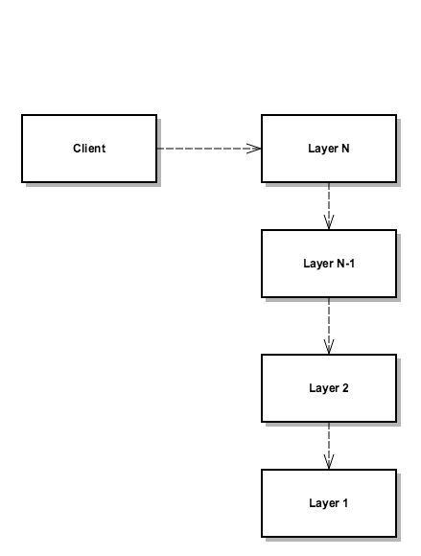
Solution
UML dependency
Structure the system into an appropriate number of layers, and place them on top of each other
Each layer represents a level of abstraction
Classes are placed in layers based on their levels of abstraction
Layer 1 is at the bottom and contains classes closest to the hardware/OS
Layer N is at the top and contains classes that interact directly with the system's clients
Layer N-1 uses the services of Layer N-2 and provides services to Layer N

Slide 9
Structure
Layer N's services are used by Layer N+1
Classes in Layer N may also use each other
There are no other direct dependencies between layers

Slide 10
Implementation
Determine the number of layers (i.e., abstraction levels)
Name the layers and assign responsibilities to them
Define the interface for each layer
Error handling strategy
Part of a layer's interface is the set of errors it might return
The errors returned by a layer should match its level of abstraction
Errors received from the layer below should be mapped into higher-level errors that are appropriate for the layer above
Low-level errors should not be allowed to "leak out" and become visible to high-level layers

Slide 11
Example: Virtual machines - Java

Slide 12
Example: Virtual machines - VMware

Slide 13
Example: Networking protocol stacks

Slide 14
Example: Grouping responsibilities of software
Responsibilities
Provision of services, display of information
(e.g., in Windows or HTML, handling of user
request (mouse clicks, keyboard hits), HTTP
requests, command-line invocations, batch API)
Logic that is the real point of the system
Communication with databases, messaging systems, transaction managers, other packages
Presentation
Domain
Data Source

Slide 15
Layers vs Packages
Oracle: “A package is a grouping of related types providing access protection and name space management.”
Layers are a logical way of grouping components
Packages are a physical way of grouping components. Developers are responsible for one or more packages, packages may be units to be released.
The package structure of an application can resemble the logical (layer) structure but there are other options

Slide 16
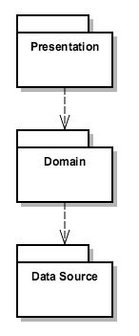
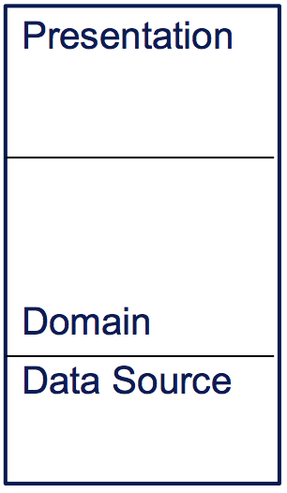
Layers vs Packages
Larman uses “UI” or “Interface” for this package
Larman uses “Application Logic” or “Domain” for this package
Larman uses “Technical Services” or “Storage” for this package
Notes:
We volgen de benaming en terminologie van Fowler vanwege de plaatsing van de patterns.

Slide 17
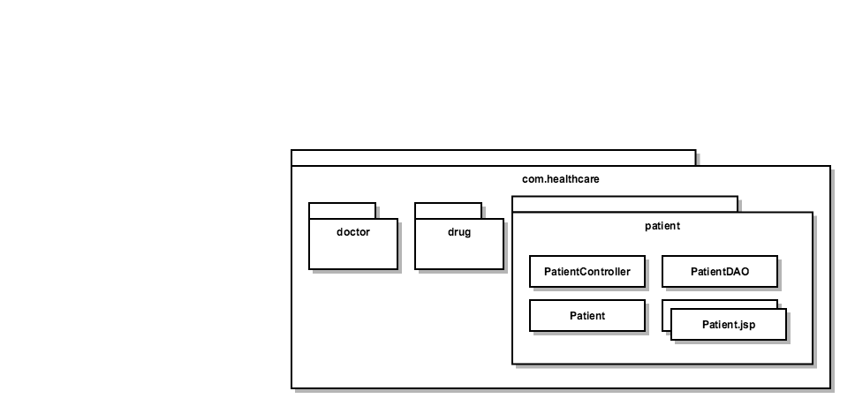
Package Organization Guidelines (Larman H35)
Package functionally cohesive (“related”) vertical and horizontal slices
Package by feature
Aggressively prefers package-private as the default scope
Optionally refine package using layers
Multiple JSPs

Slide 18
Package Organization Guidelines (Larman H35)
Use factories to reduce dependency on concrete packages
Use interfaces
Might use a DI-framework to implement factories automatically

Slide 19
Package Organization Guidelines (Larman H35)
Notes:
Factories kun je zelf bouwen maar DI-frameworks zoals Spring en Guice kunnen dit ook voor je doen. We hebben het voorbeeld uit het Larman boek genomen omdat dit boek beschikbaar is, helaas is het niet UML 2.0 compliant

Slide 20
Package Organization Guidelines (Larman H35)
Factor out independent types

Slide 21
Package Organization Guidelines (Larman H35)
No cycles in packages (also DI here)

Slide 22
Package Organization Guidelines
Allow packages to depend only on antecedents, that is, only on those packages that "come before" it in the package's fully-qualified name.

Slide 23
Pattern categories mapped to layers
Model View Controller
Page Controller
Web Presentation Patterns
Session State Patterns
Data Transfer Object (DTO)
Presentation
Domain
Data Source
Domain Model
Service Layer
Distribution Patterns
Domain Logic
Patterns
Table Data Gateway
Offline Concurrency Patterns
Data Source Architectural Patterns
Object-Relational … Patterns
Notes:
De patterns in de gele blokjes gaan we actief gebruiken. Alleen kort opsommen voor een globale indruk van de studenten, later in detail bespreken als we per laag gaan realiseren.

Slide 24
Resources
Patterns of Enterprise Application Architecture, Fowler
Pattern-Oriented Software Architecture, Vol. 1, Buschmann, et al
Design Patterns, Architectural Patterns, Dr. Jean-Claude Franchitti, New York University
Applying UML and Patterns, Craig Larman

